Slide 1
X- ray radiation
■ The Biologic effect of ionizing radiation on tissues can
be divided into:
1-Very sensitive tissue (hematopoietic tissue, blood cell, lymphatic tissue, spleen, skin, male and female reproductive tissue )
2-Less sensitive tissue (lung, kidney, liver)
3-Resistant tissue to radiation (neural tissue).

Slide 2
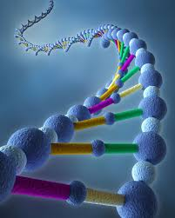
X- ray radiation
2■Genetic risk
(Biologic effect of ionizing radiation)
● Genetic mutation
● Chromosomal aberration

Slide 3
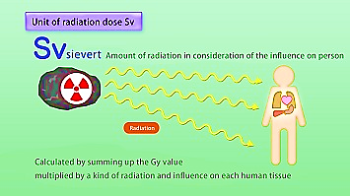
X- ray radiation
■ Radiation effect influenced by:
1-Total dose ( mSv)
2-Dose rate
3-Total area covered
4-Type of tissue
5-Age

Slide 4
X- ray radiation
● Scientific unit of measurement of radiation dose
* Millisievert (mSv)
●Other unit of measurement of radiation dose include,
* Rad (radiation absorbed dose)
* Rem (radiation equivalent man)
* Roentgen
* Sievert (1sievert=1000 mSv)
* Gray

Slide 5
X- ray radiation
■ Symptoms that appear on the person during the day after being
exposed to radiation:
● 0 - 250 mSv: no symptoms show
● 250 - 1000 mSv: Some people feel nausea, loss of appetite, affected bone marrow, affected
lymph nodes, skin peeling,
● 1000 to 3000 mSv: mild to severe nausea, loss of appetite, ease of infection, severely
affected bone marrow, severely affected lymph nodes, skin flaking,
improvement of the condition is possible but not certain.
● 3000 - 6000 mSv : severe nausea, loss of appetite; Bleeding, ease of infection, diarrhea,
skin flaking, infertility, death if not treated.
● 6000 - 10000 mSv : Above symptoms In addition to the nervous system injury, paralysis,
the probability of death is significant.
● Above 10,000 mSv (above 10 Sv): paralysis and death.

